Slide 1
AFROTC JAG Pathways Recruiting Training
Created By:
Capt Nethania Swanson, Det 585
Nethania.swanson@duke.edu
CAO: 10 July 2021

Slide 2
Overview
Air Force Law Snapshot
Educational Delay
Graduate Law Program (GLP)
One-Year College Program (OYCP)
Commissioning Actions for GLP & OYCP Cadets
USAF JAG Summer Internship Program
Educational Benefits
Student Loan Repayment Program (JA-SLRP)
Judge Advocate Continuation Pay Program (JACP)
Attorney Bar License Reimbursement (ABLRS)
Promotion Opportunities
JAG Contact Roster

Slide 3
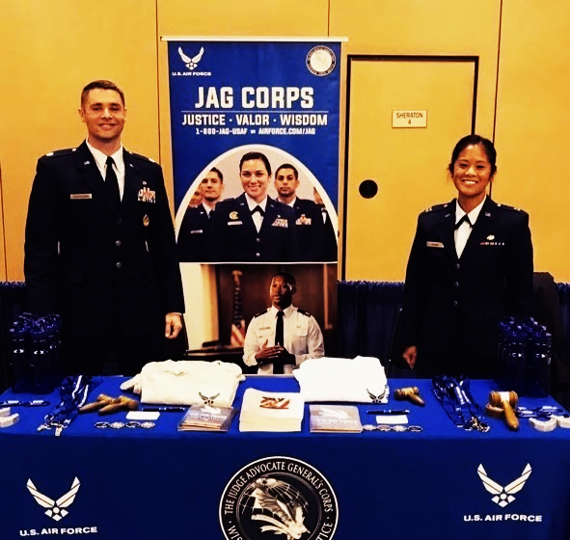
Air Force Law Snapshot
Air Force Lawyer = Judge Advocate General (JAG)
Three pathways to becoming a JAG
Educational Delay Program: join AFROTC, then apply for JAG Corps during Spring of Senior year
Graduate Law Program (GLP): join ROTC in second and third years of law school
One-Year College Program (OYCP): join ROTC in third year of law school
All pathways lead to commission as an officer and appointment as a JAG
Each pathways leads to a four-year commitment
Due to their advanced education, JAGs begin active duty as a 1st Lt and are eligible for promotion to Captain after six months of active duty
Find out more information here: https://www.airforce.com/careers/specialty-careers/jag/overview
Notes:
Image source: https://www.facebook.com/USAFJAG/posts/through-saturday-capt-jackie-sitjar-and-maj-tyler-musselman-will-be-representing/2369862156388128/

Slide 4
Educational Delay
Ed-Delay In:
Eligible for AFROTC Seniors who want to delay their entry to Active Duty in order to study law.
Applicants must meet 2 boards
Must Apply to AFIT & JAG Corps
Take the LSAT
Apply and be accepted to Law School
Cadets selected will commission and be placed in the IRR
Ed- Delay Out:
Eligible for 3rd year Law Students
Apply to JAG Corps
Application Deadlines:
10 January: Online application must be submitted
1 February: Staff Judge Advocate interview must be completed
15 March: Application to AFIT must be submitted
Apply here: http://www.airforce.com/jag

Slide 5
Educational Delay-In Continued
Educational Delay-In Package:
AF Form 477, Application for Delay from Extended Active Duty (AFROTC)
Proof of acceptance into grad school
AF Form 1082, Ed Delay Plan
Official undergrad transcript
Law School Admission Test Scores
AFOQT Test Scores
Field Training Evaluation
A Letter of Evaluation from the Det/CC
AFIT Application:
Must apply NLT 15 March to AFIT
ROTC Det/CC must email Ed Delay-in package to Ms. Kathy Royse (Kathleen.Royse.Ctr@afit.edu; (937) 255-2259, Ext. 3053) and Capt Jeffrey Lowder (Jeffrey.Lowder@afit.edu)
Packages must be submitted 90 calendar days prior to cadet’s commissioning date

Slide 6
Ed Delay Continued
Law School Funding:
Out of Pocket Expense
No stipend
Participate in a paid internship during 2nd and 3rd year of Law School
Temporarily placed on Active-Duty TDY Status for 60-89 days.
Receive full benefits (AD pay, medical, per diem, and travel allowance)

Slide 7
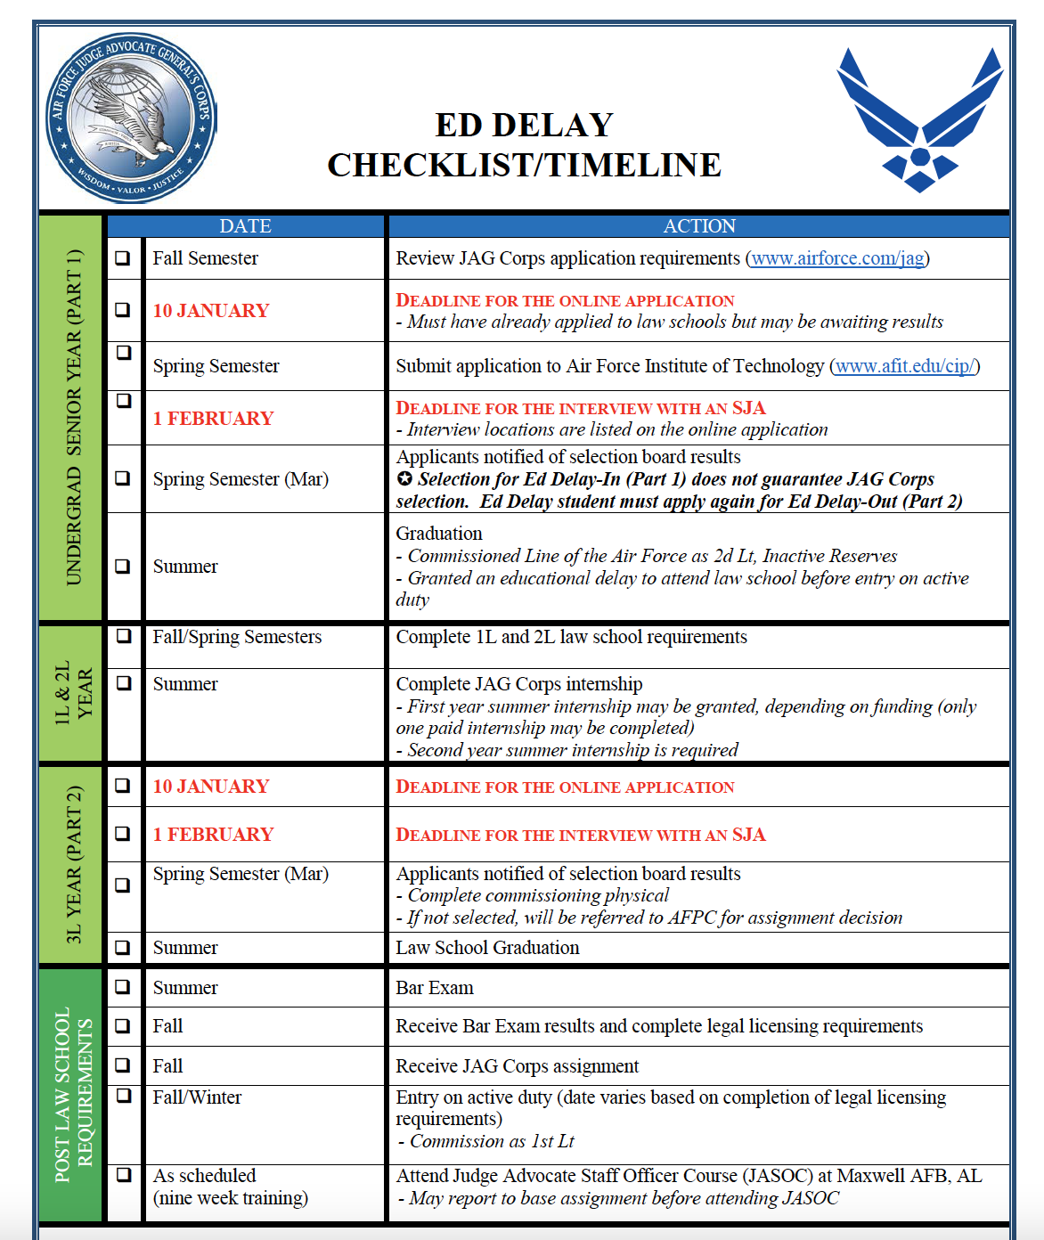
Ed Delay Checklist & Timelines
The Ed Delay Checklist can be found in the Intranet under:
“Registrar >Recruiting Branch (RRR) > special programs (located at the bottom right)”

Slide 8
Graduate Law Program (GLP)
Eligibility to apply:
Two-year program for first year law students to participate in AFROTC
Must interview with an AFROTC Det/CC before applying to JAG Corps
Apply to JAG Corps
AFROTC Requirements:
Complete AFROTC AS100-400 courses
Complete Field Training
Commission as a 2d Lt and placed into the IRR until bar exam is passed
Post-Commissioning:
Lts will work their assignments directly with Chief of Accessions Branch, (Lt Col Sara Carrasco: sara.carrasco@us.af.mil or (703) 614-2373)
Lts can expect to EAD January of the following year
Application Deadlines:
10 January: Online application must be submitted
1 February: Staff Judge Advocate interview must be completed
Apply here: http://www.airforce.com/jag
*The JAG Corps does not award any scholarships for participation in these programs*

Slide 9
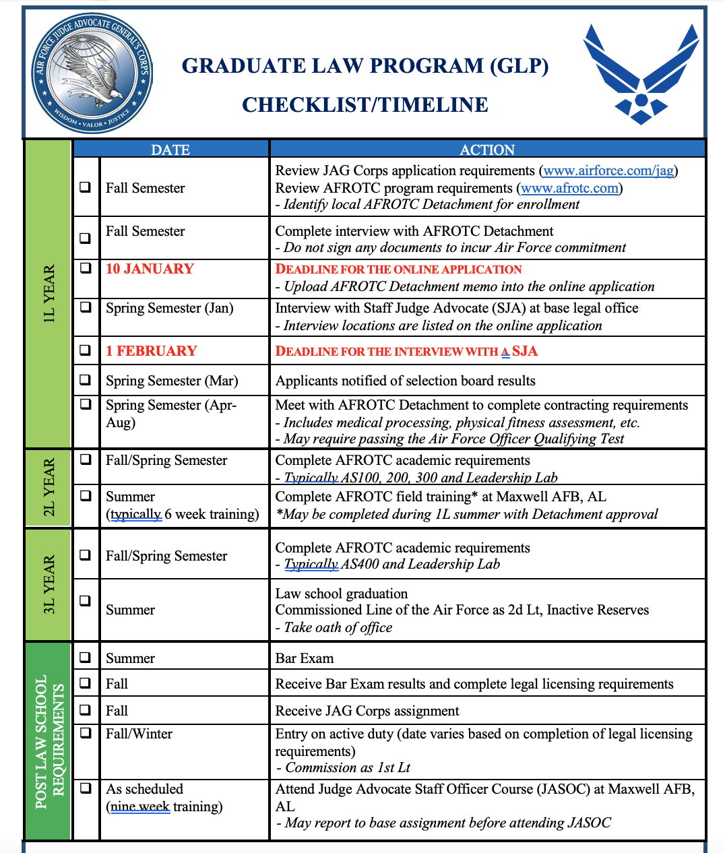
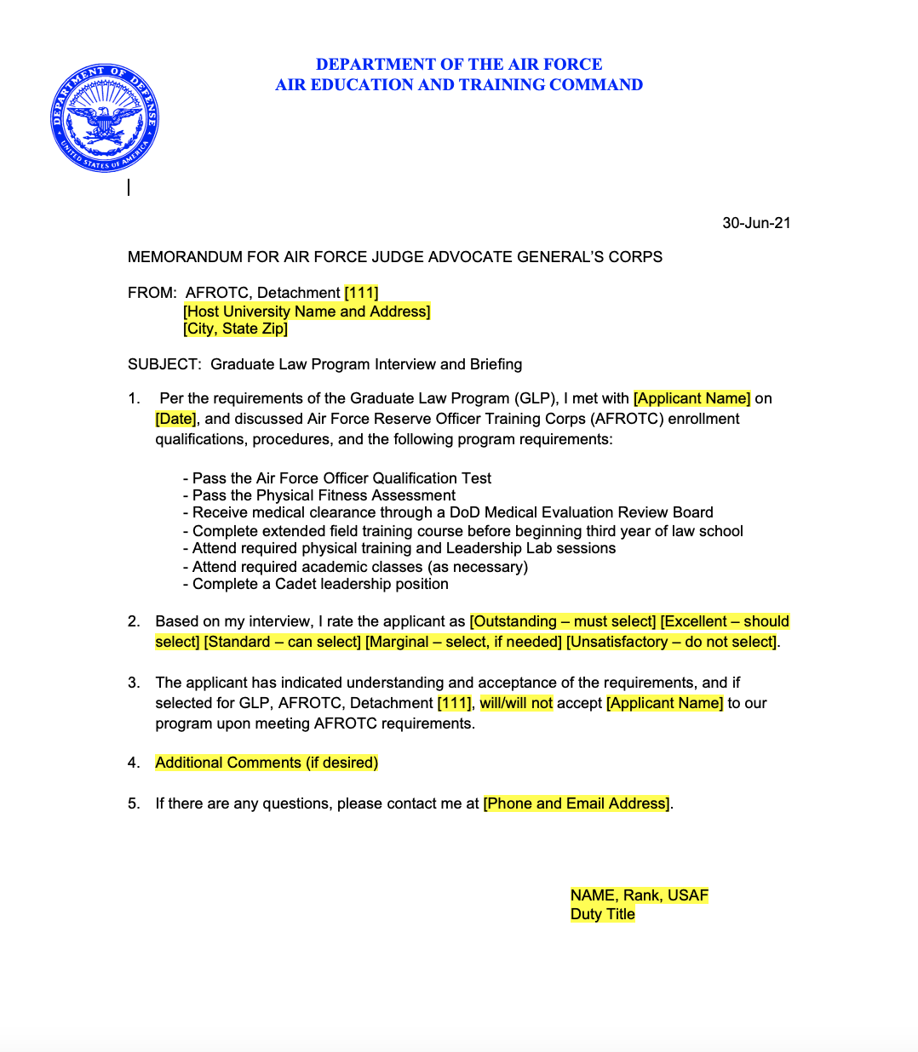
GLP Det/CC MFR & Checklist
The GLP Det/CC MFR & Checklist can be found in the Intranet under:
“Registrar >Recruiting Branch (RRR) > special programs (located at the bottom right)”

Slide 10
One-Year College Program (OYCP)
Eligibility to apply:
One-year program for second year law students to participate in AFROTC
Must interview with an AFROTC Det/CC before applying to JAG Corps
Apply to JAG Corps
AFROTC Requirements:
Complete AFROTC AS100-400 courses
Complete Field Training
Commission as a 2d Lt and placed into the IRR until bar exam is passed
Post-Commissioning:
Lts will work their assignments directly with Chief of Accessions Branch, (Lt Col Sara Carrasco: sara.carrasco@us.af.mil or (703) 614-2373)
Lts can expect to EAD January of the following year
Application Deadlines:
10 January: Online application must be submitted
1 February: Staff Judge Advocate interview must be completed
Apply here: http://www.airforce.com/jag
*The JAG Corps does not award any scholarships for participation in these programs*

Slide 11
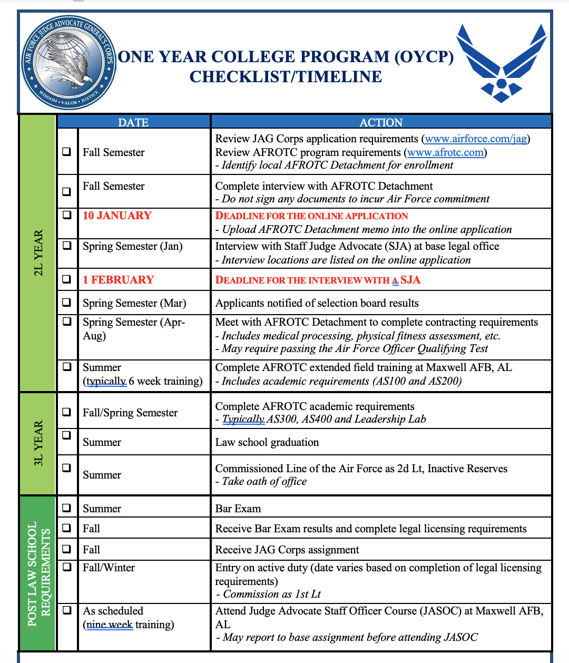
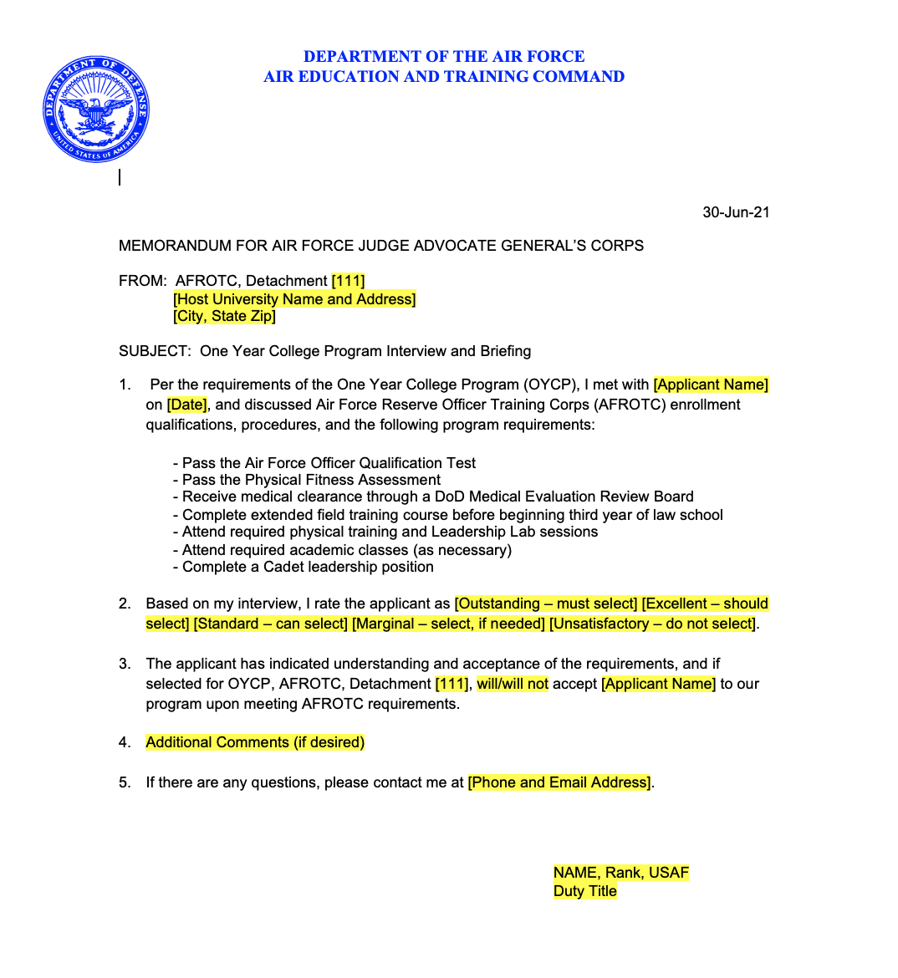
OYCP Det/CC MFR & Checklist
The OYCP Det/CC MFR & Checklist can be found in the Intranet under:
“Registrar >Recruiting Branch (RRR) > special programs (located at the bottom right)”

Slide 12
GLP/OYCP Cadets Commissioning Actions
AFROTCI 36-2011, Para. 17.3.13
When filling out the AF Form 133, (Oath of Office), do not enter Judge Advocate Career Field
GLP & OYCP Cadets will commission as line officers upon successful completion of AFROTC & their law degree requirements
In the event of licensing failure (failure to pass the state Bar Exam), GLP/OYCP Commissionees are not discharged. They will be reassigned to a non-JAG AFSC as a 2d LT
Once GLP & OYCP Cadets pass their bar, they will work with the JAG Accessions Branch Chief to work their assignment.
Once they EAD as a JAG and they will be promoted to 1st Lt
After 6 months on station, they will promote to Captain

Slide 13
Financial Opportunities, Incentives & Benefits
(Proceed to next slide)

Slide 14
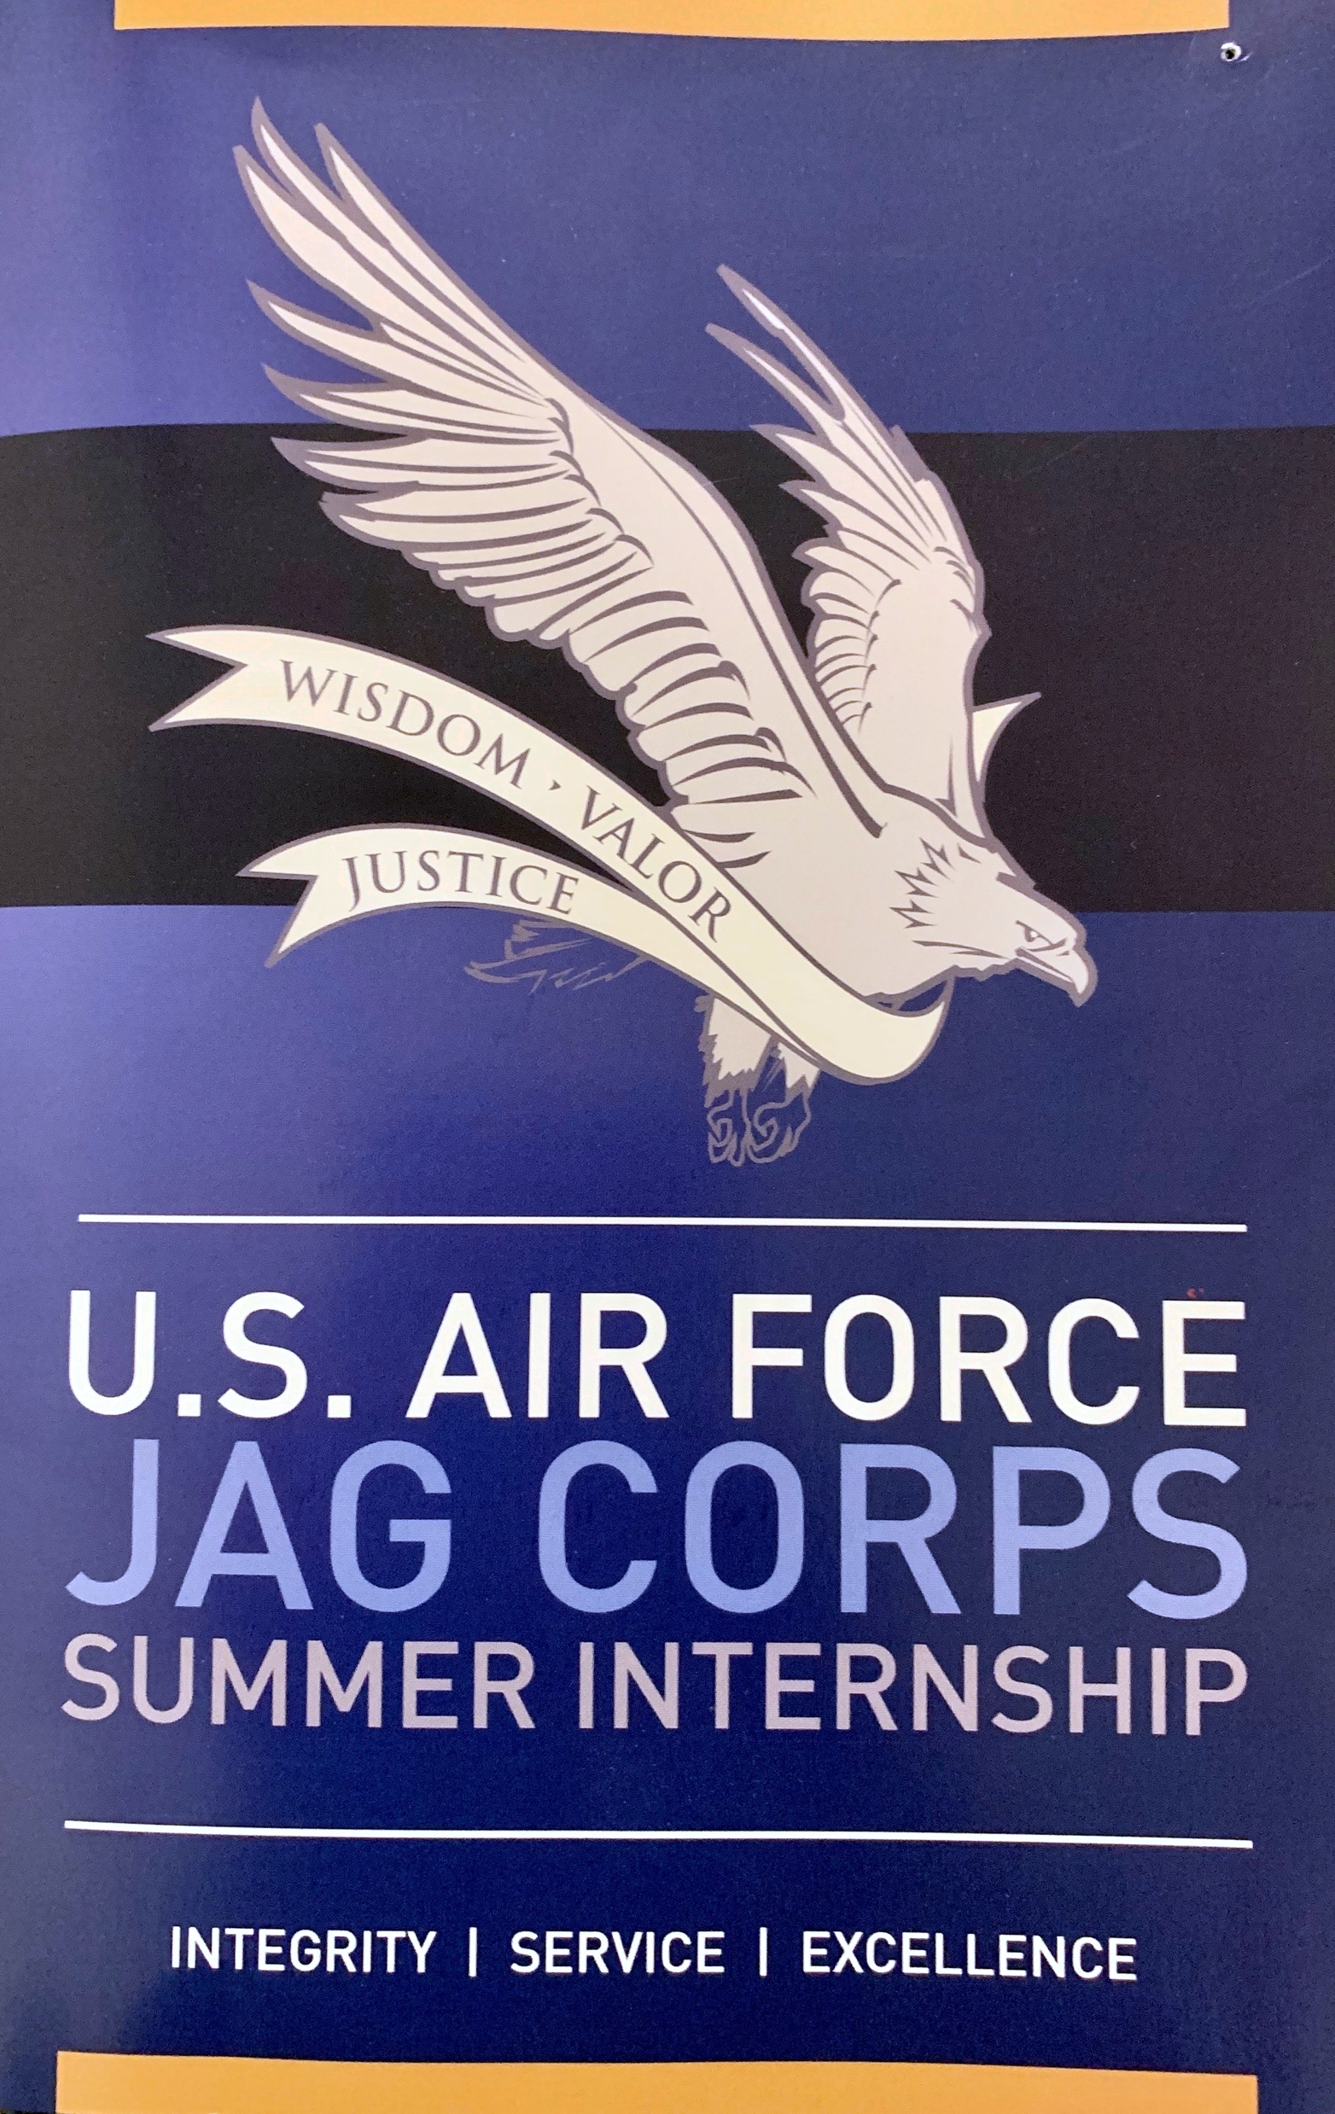
USAF JAG Summer Internship Program
Application
Application process and deadline to apply for a paid internship is available on www.USAJOBS.com in early fall (search term: “Air Force JAG”)
Requirements:
U.S. Citizen
Second-year law student (at time of application)
J.D. degree candidate at an ABA-accredited law school
Serve 8-10 weeks during the summer in the continental U.S.

Slide 15
Education Benefits
Compete and apply for a tuition-free Master of Laws (LL.M.) Program in specialties such as:
Government Contract Law
Environmental Law
Labor Law
Cyber Law
Air & Space Law
International Law
Target: Senior Captains and Majors
Benefits:
Full tuition
Fees and book allowance
Full AD benefits (pay, allowances, medical
Notes:
Source: https://www.airforce.com/careers/specialty-careers/jag/benefits/education-benefits
Image source: https://www.indiaeducation.net/studyabroad/programs/humanities/masters-in-law.html

Slide 16
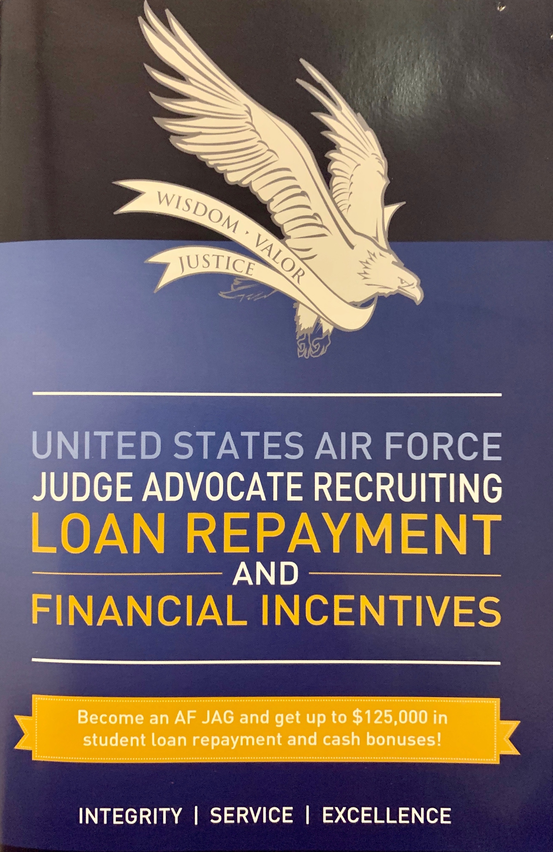
Student Loan Repayment Program (JA-SLRP)
Eligible JAGs can apply for up to $65,000 toward student loan repayment
No additional Active-Duty Service Commitment!
How it works:
Payments are divided over 3 years (at the end of years 2, 3, and 4 JAG Corps service)
Payments are made directly to the lender
No more than one-third of any loan paid per year
Eligible:
Direct Appointment Program (DAP), GLP, OYCP
JAGs may also benefit from the Public Service Loan Forgiveness Program and income-based loan repayment plan of the College Cost Reduction and Access Act of 2007.
Notes:
Source: https://www.airforce.com/careers/specialty-careers/jag/benefits/education-benefits & AF JAG Financial Incentives Brief (dated May 2021)

Slide 17
Judge Advocate Continuation Pay Program (JACP)
JACP is a retention program
After you complete your 4-year service obligation, you can qualify for the service to pay you up to $60,000 if you stay in the Air Force.
Sign up for another two years after your initial four-year commitment and you receive $20,000.
At six years, sign up for four more years and receive another $40,000.
This program is contingent on annual Congressional approval
Can be used for any purpose
Taxes withheld at a 25% rate
Must be within an approved eligibility window (outlined in next two slides)
Notes:
Source: https://www.airforce.com/careers/specialty-careers/jag/benefits/education-benefits & AF JAG Financial Incentives Brief (dated May 2021)

Slide 18
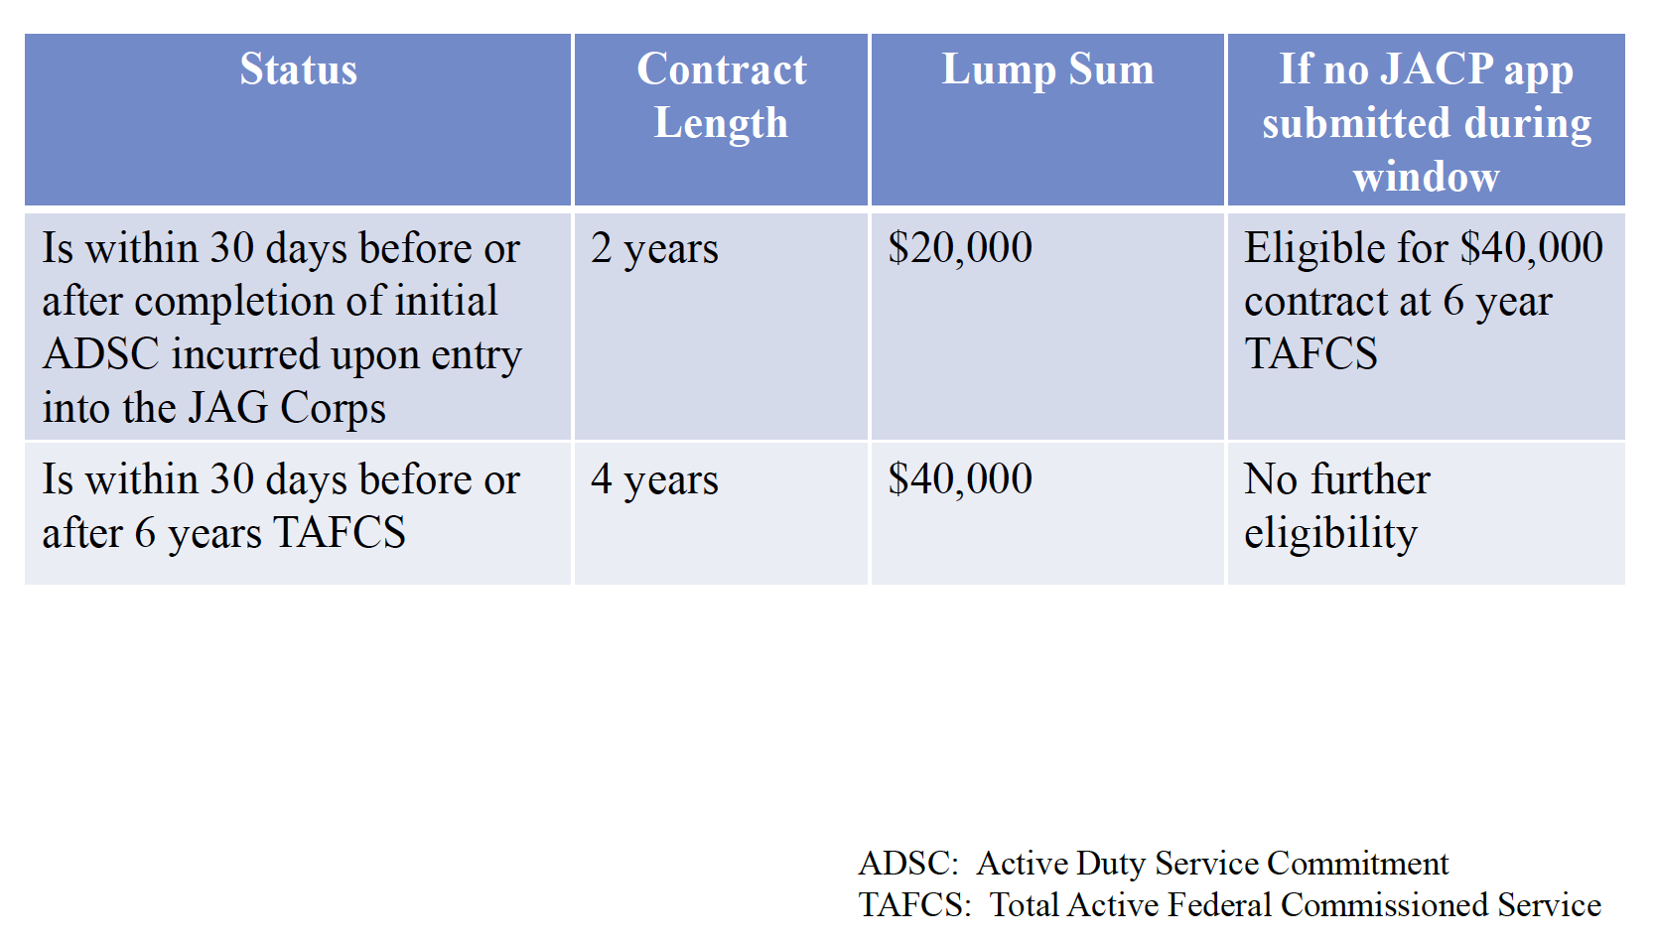
JACP (No Prior Commission)
Notes:
Source: https://www.airforce.com/careers/specialty-careers/jag/benefits/education-benefits & AF JAG Financial Incentives Brief (dated May 2021)

Slide 19
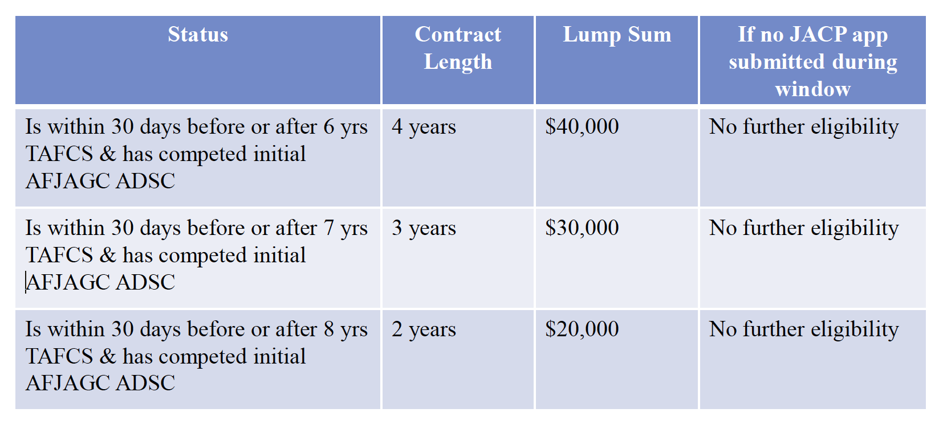
JACP (Prior Commission Service)
Notes:
Source: https://www.airforce.com/careers/specialty-careers/jag/benefits/education-benefits & AF JAG Financial Incentives Brief (dated May 2021)

Slide 20
Attorney Bar License Reimbursement System (ABLRS)
Qualifying Expenses:
The cost of membership in a state of U.S. territorial bar, if required to practice law in that jurisdiction
Does not include the following:
Late Fees
Electronic payment fees (unless mandatory)
Membership in bar sections
The rate is typically set at $350 max for annual payments ($700 for those who pay biennially)
Save your receipts!
Notes:
Source: https://www.airforce.com/careers/specialty-careers/jag/benefits/education-benefits & AF JAG Financial Incentives Brief (dated May 2021)

Slide 21
Promotion Opportunities
“Judge Advocates are considered for promotion in a separate category from other Air Force Officers. The chart below is illustrative of what is generally the case for promotions in the Air Force JAG Corps, although timing may vary.” PROMOTION TO YEARS OF SERVICE PROMOTION OPPORTUNITY Captain: 6 months 100% Major: (6–7 years) 95% Lieutenant Colonel: (13 years) 85% Colonel: (18 years) 60%
Notes:
Source: https://www.airforce.com/careers/specialty-careers/jag/benefits/education-benefits

Slide 22
Contact Roster
JAG Recruiting
Email: airforcejagrecruiting@gmail.com
1-800-JAG-USAF
www.facebook.com/USAFJAG
JAG Recruiting Branch Chief
Major Meghan Campbell
Email: megan.campbell.10@us.af.mil
Phone: (703) 614-2371/3021
JAG Accessions Branch Chief
Lt Col Sara Carrasco
Email: sara.carrasco@us.af.mil
Phone: (730) 614-2373

